Slide 1
Heart Disease Diagnostic Analysis
DETAILED PROJECT REPORT

Slide 2
INTRODUCTION
Health is a vital asset, especially emphasized during the COVID-19 pandemic. This project analyzes heart disease data to prepare for future health challenges. Using Python for ETL and EDA, we explore heart disease rates by gender, age, and other attributes. The goal is to create insightful dashboards that reveal key metrics and relationships, enhancing our understanding and response to heart disease.

Slide 3
Problem statement
Health is real wealth, as the pandemic has shown the severe effects of health crises on everyone, regardless of status. This project aims to analyze heart disease data to better prepare for future health challenges. By examining medical data, we seek to uncover critical insights and trends, ultimately contributing to improved health outcomes and preparedness.

Slide 4
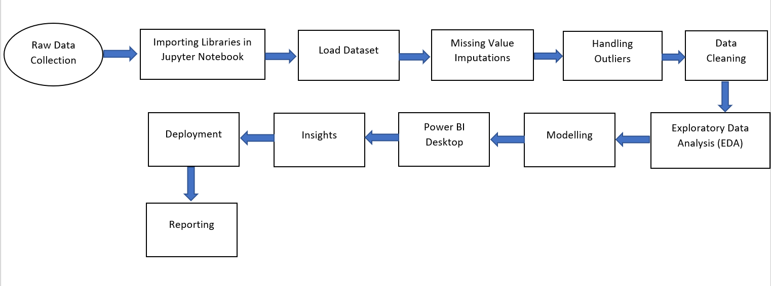
architecture

Slide 5
Dataset Information
Age: The person's age in years
Sex: The person's sex (1 = male, 0 = female)
Chest Pain Type (cp): 1: Typical angina 2: Atypical angina 3: Non-anginal pain 4: Asymptomatic
Resting Blood Pressure (trestbps): The person's resting blood pressure (mm Hg on admission to the hospital)
Serum Cholesterol (chol): The person's cholesterol measurement in mg/dl
Fasting Blood Sugar (fbs): Fasting blood sugar > 120 mg/dl (1 = true; 0 = false)
Resting Electrocardiographic Results (restecg) 0: Normal 1: Having ST-T wave abnormality 2: Showing probable or definite left ventricular hypertrophy by Estes' criteria
Maximum Heart Rate Achieved (thalach): The person's maximum heart rate achieved
Exercise Induced Angina (exang): Exercise induced angina (1 = yes; 0 = no)
Oldpeak: ST depression induced by exercise relative to rest
Number of Major Vessels (ca): The number of major vessels (0-3) colored by fluoroscopy
Thalassemia (thal) - 0: Normal 1: Fixed defect 2: Reversible defect

Slide 6
Key Performance indicator (KPI)
Percentage of People Having Heart Disease
Age Distribution including Gender
Gender Distribution Based on Heart Disease
Chest Pain Experienced by People Suffering from Heart Disease
Blood Pressure, Cholesterol Level and Maximum Heart Rate of People According to their Age and Heart Disease Patients.
ST Depression Experienced by People According to their age and heart disease

Slide 7
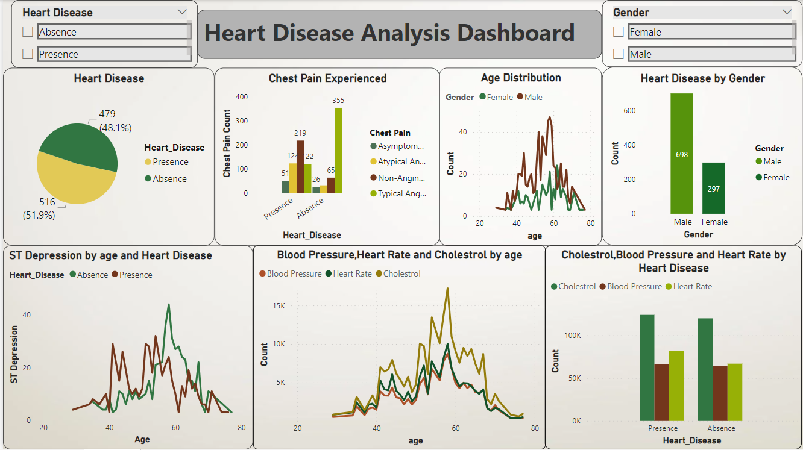
Dashboard

Slide 8
Thank you

Slide 9
Analyzing Amazon Sales Data
DETAILED PROJECT REPORT

Slide 10
Introduction
Amazon Sales Data Analysis is crucial for understanding consumer behavior, sales trends, and other key metrics that drive business success. With millions of sellers worldwide, analyzing this data helps make informed, data-driven decisions to sustain and grow their businesses profitably. By focusing on metrics such as Total Sales, Sales Quantity, Total Profit, and Last Year Sales, we can gain insights into market trends and customer buying behaviors. This analysis not only enhances performance but also helps identify what customers truly want, leading to better market strategies and improved customer satisfaction.

Slide 11
Problem statement
In the face of rising competition and the demand for more efficient distribution methods, sales management has become increasingly vital. It plays a crucial role in reducing costs and boosting profits, making it one of the most important functions in any commercial and business enterprise today. The challenge lies in optimizing sales management strategies to stay competitive and achieve sustained business growth.

Slide 12
Architecture

Slide 13
Dataset Information
ORDER ID: unique identifier assigned to each order.
Order date: the date when the product was ordered.
Region: the region where the customer resides.
Country: the country of the customer's residence.
Item type: the category or type of item sold on amazon.
Sales channel: the mode of shopping, whether online or offline.
Order priority: the priority level of the order, ranging from low to high.
Ship date: the date when the product was dispatched.
Unit sold: the number of units sold per product.
Unit cost: the cost of the product per unit.
Unit price: selling price of the product
Total revenue: the total revenue generated from sales.
Total cost: the total cost incurred by the company.
Total profit: the total profit earned by the company.

Slide 14
Key performance indicator (KPI)
Total Profit by Region
Total Profit by Year
Unit Sold by Sale Channel
Unit Sold by Item Type
Unit Sold by Region
Total Sale and Cost by Item
Total Profit by Sales Channel

Slide 15
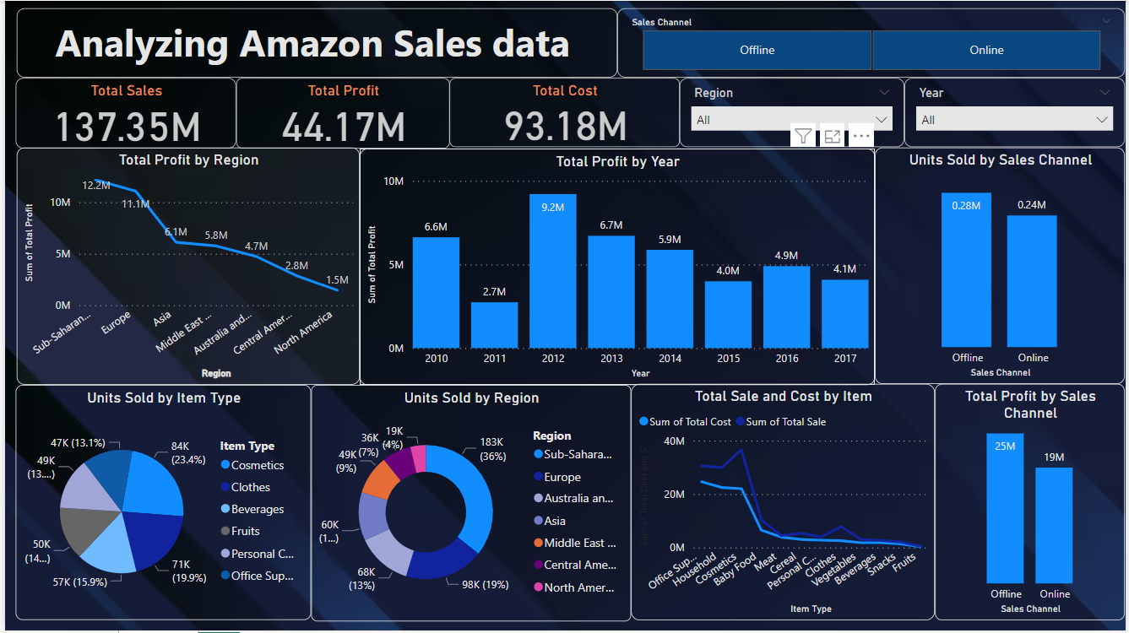
Dashboard

Slide 16
Thank You

